Slide 1
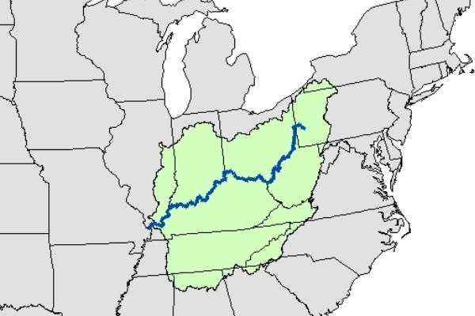
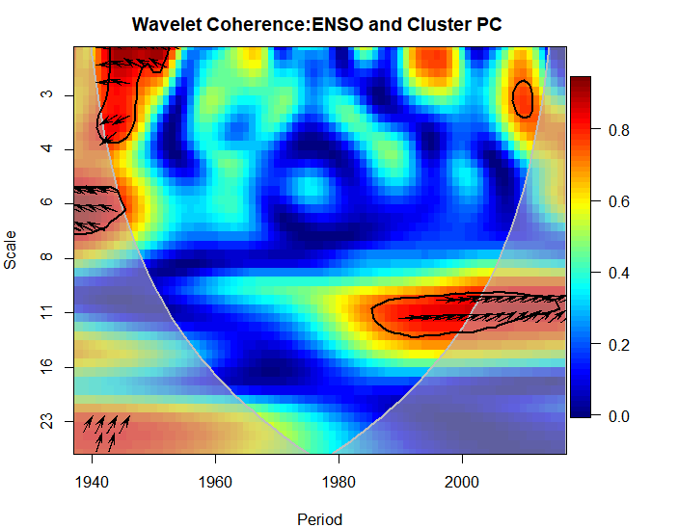
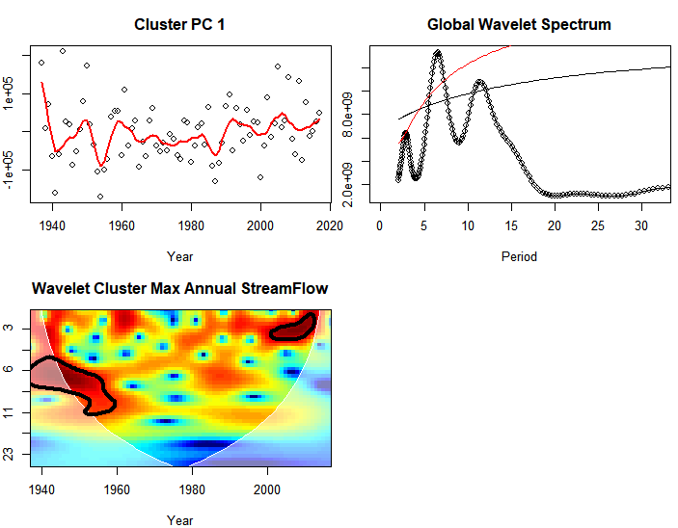
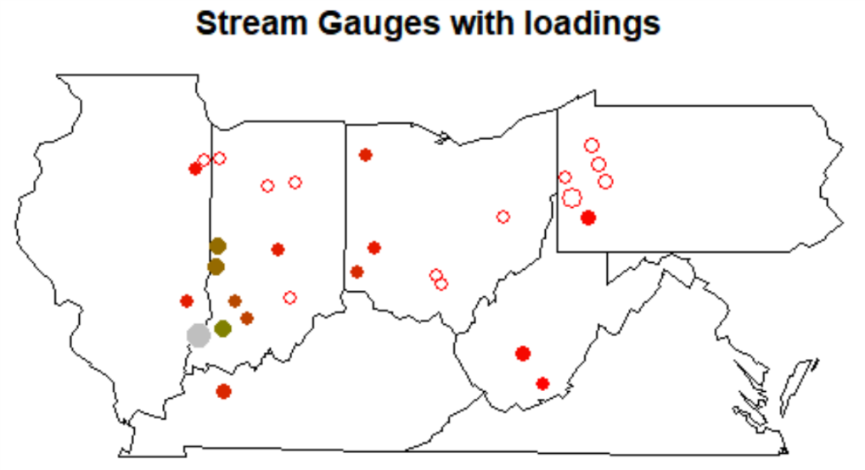
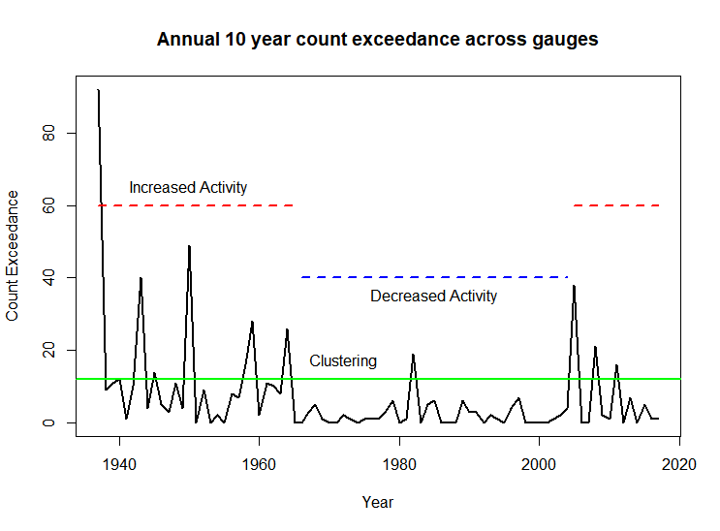
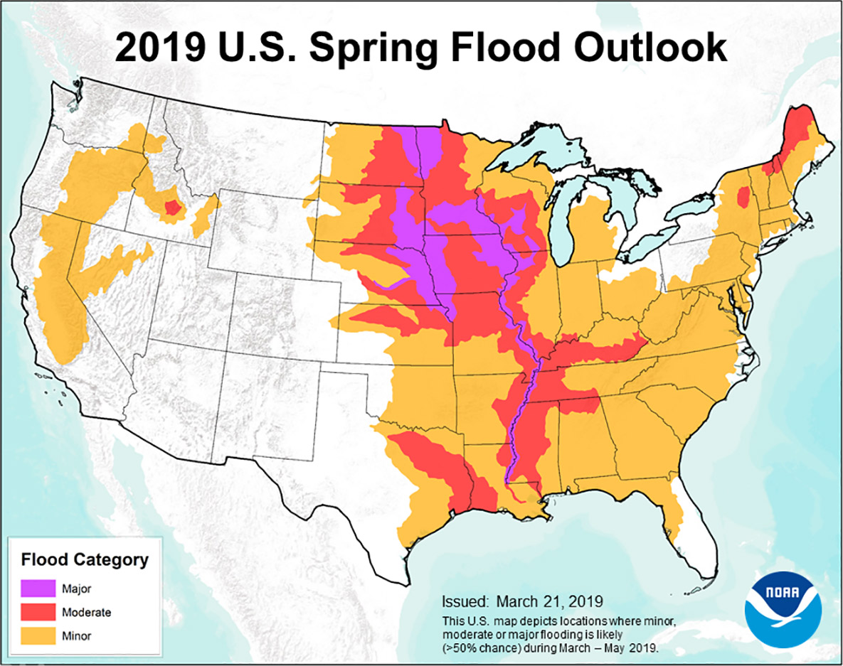
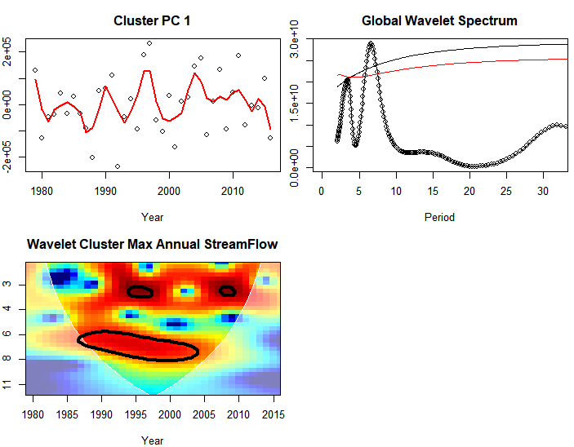
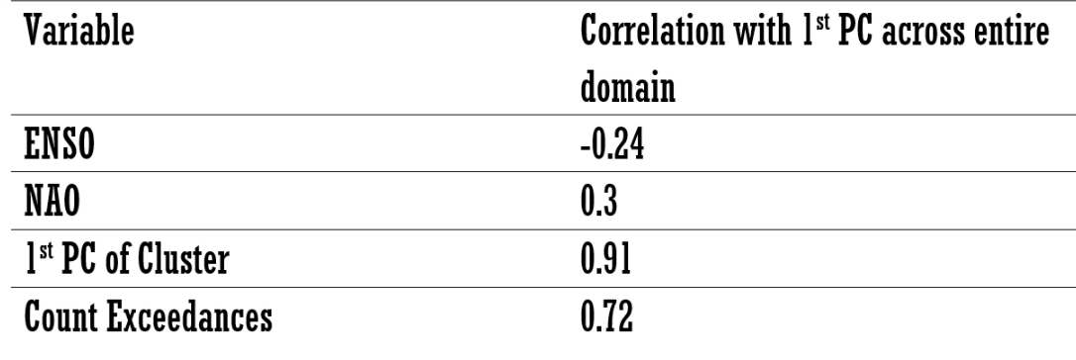
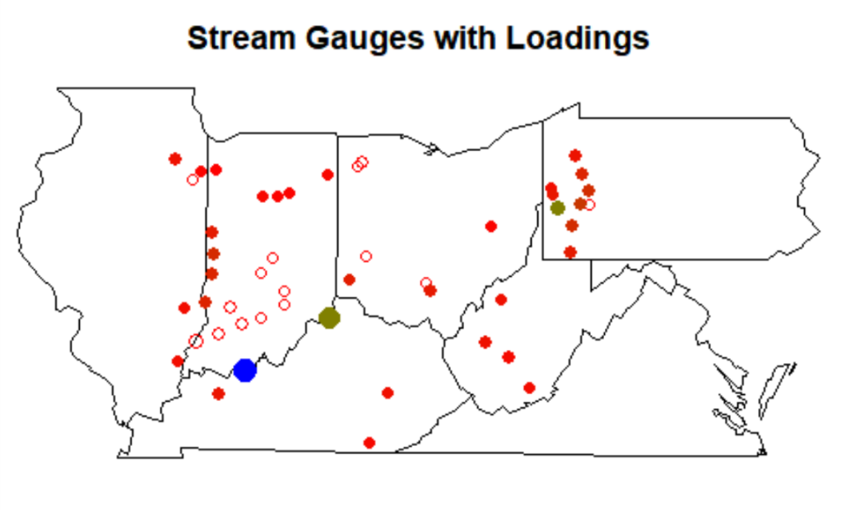
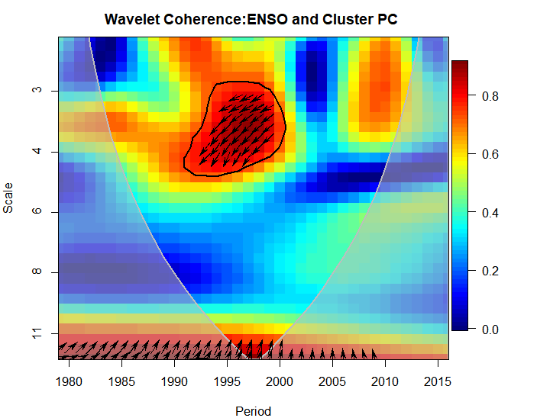
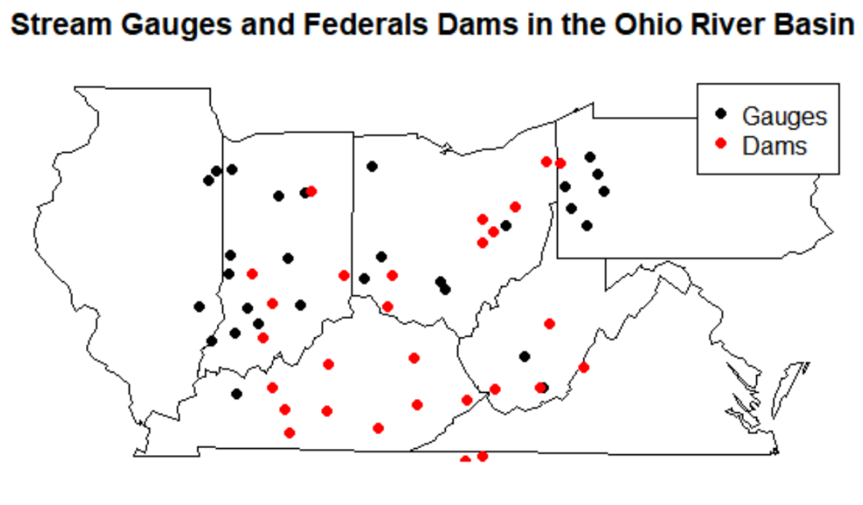
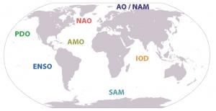
Spatiotemporal Clustered Risk of Flooding in the Ohio River Basin and American Midwest.
Yash Amonkar, Upmanu Lall
Department of Earth and Environmental Engineering, Columbia Water Center, Columbia University.
Introduction
Floods led to more than half a million deaths worldwide from 1980-2009¹.
Clustered flood occurrences across large regions are particularly catastrophic. This has been observed in the Mid-western USA since the 1930s.
Moseley (1939): “…the centers of greatest storminess over the United States and Canada shift in both latitude and longitude. After moving east for a number of years the location of these centers returns abruptly to a position much farther west. It may be that after ninety years the storm centers return to very nearly the same place which they had at the beginning.”
Brooks(1937)“The conditions causing the excessive rainfall of up from 13 inches in southwestern Indiana to 12.7 in north- central Ohio in March, 1913, were almost identical with those of January, 1937”
Research Question:- What can we infer as to space-time clustering of floods from historical streamflow data from the Ohio River Basin?
1 - Doocy, S., Daniels, A., Murray, S., & Kirsch, T. D. (2013). The human impact of floods: a historical review of events 1980-2009 and systematic literature review. PLoS currents, 5.
Ohio River Basin
Results
The Ohio River Basin and upper Mississippi has a long history of large scale regional flooding in 1882,1913,1937,1997 and most recently in 2011.
Unlike most other regions, the flooding in this basin is dominated by the precipitation and/or snow melt. Though like most floods there are numerous reasons leading up to it.
Figure 4: Ohio River Basin. Credit - Orsanco
Figure 6:- Coherence of the 1st Principal Component with ENSO.
Springtime extreme streamflow in the Ohio River Basin is driven by a unique, recurrent, persistent, and strong atmospheric anticyclonic circulation anomaly pattern.
There are clear associations between synoptic circulation types and historical extreme (“10 year”) flood events on the Ohio River Basin. These two circulation types were both found to be preferentially associated with La Niña, providing one causal mechanism for the recent flooding during April of 2011
1. Nakamura, J., Lall, U., Kushnir, Y., Robertson, A. W., & Seager, R. (2013). Dynamical structure of extreme floods in the US Midwest and the United Kingdom. Journal of Hydrometeorology, 14(2), 485-504.
2. Farnham, D. J., Doss‐Gollin, J., & Lall, U. (2018). Regional Extreme Precipitation Events: Robust Inference From Credibly Simulated GCM Variables. Water Resources Research, 54(6), 3809-3824.
3. Robertson, Andrew W., et al. "Weather and climatic drivers of extreme flooding events over the midwest of the United States." Extreme Events: Observations, Modeling, and Economics (2015): 113-124.
2019 Midwest Flooding
1. https://www.noaa.gov/media-release/spring-outlook-historic-
widespread-flooding-to-continue-through-may
2. https://www.nytimes.com/2019/05/24/us/midwest-river-flooding.html
3. NOAA – National Temperature and Precipitation Maps.
4. https://www.wired.com/story/for-the-midwest-epic-flooding-is-the-face-of-climate-change/
Figure 5 :- Wavelet Analysis on the 1st Principal Component of the spatial cluster. TOP-LEFT – 1st PC of cluster with a loess line. TOP-RIGHT – Global Wavelet Spectrum of the PC. BOTTOM-LEFT – Power Spectrum of the Wavelet. BOTTOM-RIGHT – Spatial Distribution of the Loadings(Size indicates their drainage area.
This forecast has turned out true with record breaking floods across the Mid-west, surpassing the last great floods of 1993^{1,2}. This has been the wettest 12 months in the history of United States since 1895³, and the longest flood duration since 1927 on the Mississippi
Across the media, climate change is invoked^{2,4}. However, the region has a 200 year history of great floods that are synchronous across the region
Figure 7:- Regional Exceedances of Annual 10 year return flood per site (1937 was a very exceptional year)
Methodology
Streamflow
Daily Data from 29 stations for the period 1937-2017, and 49 stations for 1979-2017 were used.
Streamflow gauges were selected which had a drainage area greater than 1450 sq. Miles.
Wavelet Clustering: Are there common recurrent patterns of flooding with a characteristic frequency?
Compute Wavelet spectra for each streamflow site.
Hierarchical Clustering of Wavelet Spectra to identify common time-frequency structure in flooding. Using Silhouette Analysis the number of clusters in the field were identified.
For each cluster, principal component analysis was carried out on the field and the 1st PC was selected.
Wavelet Analysis was carried out on the 1st PC to illustrate the identified time-frequency pattern
Compute Wavelet for the 1st PC for each cluster and the relevant Climate Indices.
For a robust inference, nested analysis was carried out using more station data but a shorter study period of 39 years(1979-2017).
Regional 10 year flood exceedance process: How many days of flooding across stations occurred > 10 year flood across sites in each year?
At each site, based on the maximum likelihood method, the 10-yr return period was computed.
For each year, the number of daily flow exceedances over the 10 yr. return period were computed and aggregated.
Poisson Regression: Can the flood exceedances be linked to and predicted from global climate indices – attribution of clustering?
The exceedance time series was regressed against the various climate indices and interactions between the climate indices.
For the interaction we considered the interactions between NAO and PDO along with the interactions between NAO and ENSO.
Climate Index Interactions were computed by multiplying the individual JFM seasonal anomalies.
Figure 9:- Correlations of ENSO – Nino 3.4, NAO, 1st PC of cluster(Figure 5) and Exceedances(Figure 7) with the 1st PC of ann. Max flow across the entire domain for the 81 years
Figure 1:- NOAA 2019 Spring Flood Outlook¹
Data Sources
Hirsch, R.M., and De Cicco, L.A., 2015, User guide to Exploration and Graphics for RivEr Trends (EGRET) and dataRetrieval: R packages for hydrologic data (version 2.0, February 2015): U.S. Geological Survey Techniques and Methods book 4, chap. A10, 93 p., http://dx.doi.org/10.3133/tm4A10
Gopi Goteti and Joseph Stachelek (2016). dams: Dams in the United States from the National Inventory of Dams (NID). R package version 0.2. https://CRAN.R-project.org/package=dams
KNMI Climate Explorer - https://climexp.knmi.nl/
Figure 8 :- Wavelet Analysis on the 1st Principal Component of the spatial cluster, but for 39 years of data. TOPLEFT – 1st PC of cluster with a loess line. TOPRIGHT – Global Wavelet Spectrum of the PC. BOTTOMLEFT – Power Spectrum of the Wavelet. BOTTOMRIGHT – Spatial Distribution of the Loadings(Size indicates their drainage area.
Streamflow Gauges - USGS/Data Retrieval Package in R¹.
Dams – National Inventory of Dams/Dams package in R².
Climate Indices³
ENSO – Nino 3.4 – HadISST
PDO – JISAO
AMO – HadSST
NAO – Jones et al.
Figure 10:- Coherence of the 1st Principal Component with ENSO, but for 39 years of data.
Figure 2:- Stream Gauges and Federal Dams.
Conclusions
The Ohio River Basin shows significant clustering in the regional stream-flow with further ramifications in the understanding of the local climatology and for the design of critical infrastructure in the region.
The network of aging dams in the region, may be vulnerable to cascading failure under the spatially and temporally correlated extreme events. A repeat of the 1937 event could be catastrophic.
Nuclear power plants in the region are located near rivers, and do not have adequate protection under a scenario of upstream dam failures¹.
Large scale climate drivers induce space and time clustering in the occurrence of flooding in this region, even without an anthropogenic climate change, with significant regional impact on losses and supply chains.
Perkins, R. H., Bensi, M. T., Philip, J., & Sancakatar, S. (2011). Screening analysis report for the proposed generic issue on flooding of nuclear power plant sites following upstream dam failures. NRC, Washington, DC. US Nuclear Regulatory Commission, Office of Nuclear Regulatory Research, Division of Risk Analysis
Figure 3:- Global Climate Indices. Courtesy - UCAR

